Slide 1
Introduction to Algorithms
Binary Search

Slide 2
Binary search
We have seen the linear (sequential) search method.
Complexity of algorithm is about n/2, i.e. O(n).
Is there a better algorithm, i.e. more efficient in terms of operations/time.
The Binary search is such a method.

Slide 3
Binary search
We consider Binary search for a 1D array of numbers.
The Binary search requires the data to be in sorted order in the array.
Imagine looking for a number in the telephone directory if it was not sorted by name.
We would need to start at the beginning, and do a linear search, very inefficient and slow.

Slide 4
Binary search
Because telephone directory is sorted, we can search it much faster.
Binary search works in a similar way to this.
We assume the data in the array is sorted, will look at sorting algorithms later.

Slide 5
Binary search
Element we search for is called the key.
Array to search is A(n) of size n.
Let i = 1st index, j = last index=n.
Compute the middle index k = (i+j)/2
Check if the key = A(k)?
If it is, we have found the key, at position =k.
If key <> A(k) then either the key is in the 1st half of the array or the second half, since the array is sorted.

Slide 6
Binary search
If key < A(k) we search the sub-array: A(0),A(1),…,A(k-1)
If key > A(k) we search the sub-array:
A(k+1), …, A(n – 1)
Each of these subarrays is about half the size of the original array.
We apply this same method to the smaller array, since each one is sorted, looking at the middle element first.
We continue until the element is found, or it isn’t in the array.

Slide 7
Binary search
Algorithm. int binary_search(A, n, key)
pos = -1 // assume element not found
i := 0 // min index (initially)
j := n - 1 // max index (initially)
while (i <= j and pos = -1 )
k = (i + j)/2
  if (key = A(k) ) then // element found
  pos = k // element in k-th position
  else if (key < A(k)) then
  j := k – 1 // last index in 1st half.
  else
  i := k + 1 // 1st index in 2nd half.
  end if
  end while
  return pos
  end binary_search

Slide 8
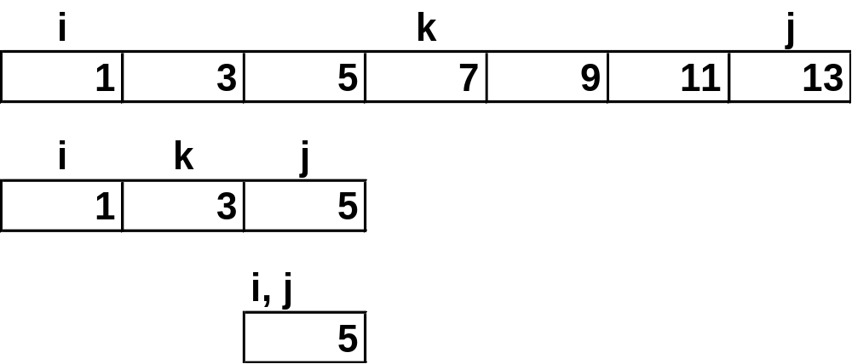
Binary search 1D array
Search array A for key = 5.
middle index k = 3. key <> A(3), so
Search 1st half, i =0, j = k – 1 = 2, k = (0+2)/2=1
Example A(*):

Slide 9
Binary search 1D array
Let’s look at complexity of the Binary search.
Easiest when n = 2^{k} -1. Then the two halves each have
  (n-1)/2 = (2^{k} – 1 – 1)/2 = (2^{k} – 2)/2 =2^{k-1} –1 elements.
Three cases to consider:
  Best case
  Worst case
  Average case
Best case: 1st element, 1 comparison
Worst case: The array is halved at each step.
Eventually the array will have only 1 element.

Slide 10
Binary search 1D array
After step 1: n = 2^{k} -1, for some integer k.
After step 2: 2^{k-1} -1
After step 3: 2^{k-2} -1
After step k: 2^{k-(k-1)} – 1 = 1
So after k steps array has only 1 element.
At most k comparisons are needed.
n = 2^{k} -1, n + 1 = 2^{k}
log₂(n+1)= log₂(2^{k}) = k
k = log(n+1) comparisons.

Slide 11
Binary search 1D array
So at most log(n+1) operations are needed.
For n = 7, log(n+1) = log(8)=3
For n = 15, log(n+1) = log(16) = 4.
When n is not = 2^{k} – 1, algorithm still works.
Average case is also log(n+1) operations.
This is a lot better than linear search.
log(n+1) << n/2, for large n

Slide 12
Binary search 1D array
Example.
If n = 1023 = 2^{k} - 1 k = 10
Linear search: 512 comparisons on average.
Binary search: 10 comparisons at most.
Exercises: Find maximum number of comparisons if:
N = 31, 32, 100, 200, 500, 1000

Slide 13
Example Array: 7 elements
 | low |  |  | mid |  |  | high
i | 0 | 1 | 2 | 3 | 4 | 5 | 6
A[i] | 10 | 15 | 20 | 25 | 30 | 35 | 40
 | 10 | 15 | 20 |  | 30 | 35 | 40
 | 10 |  | 20 |  | 30 |  | 40

